Slide 1


Tomas Kondela
18.06.2024

Slide 2

Outline
Executive Summary
Introduction
Methodology
Results
Conclusion
Appendix

Slide 3
Executive Summary
Summary of methodologies
Data Collection through API
Data Collection with Web Scraping
Data Wrangling
Exploratory Data Analysis with SQL
Exploratory Data Analysis with Data Visualization
Interactive Visual Analytics with Folium
Machine Learning Prediction
Summary of all results
Exploratory Data Analysis result
Interactive analytics in screenshots
Predictive Analytics result

Slide 4
Introduction
Project background and context
Space X advertises Falcon 9 rocket launches on its website with a cost of 62 million dollars; other providers cost upward of 165 million dollars each, much of the savings is because Space X can reuse the first stage. Therefore if we can determine if the first stage will land, we can determine the cost of a launch. This information can be used if an alternate company wants to bid against space X for a rocket launch. This project is focusing to predict success of first stage landing with machine learning approach
Problems you want to find answers
What are the factors for successful landing
Statistics of landings

Slide 5

Section 1

Slide 6
Methodology
Executive Summary
Data collection methodology:
API (https://api.spacexdata.com/v4/rockets/)
Web Scarping (https://en.wikipedia.org/wiki/List_of_Falcon/_9/_and_Falcon_Heavy_launches)
Perform data wrangling
Added labels into Training data with 1 means the booster successfully landed 0 means it was unsuccessful.
Perform exploratory data analysis (EDA) using visualization and SQL
Perform interactive visual analytics using Folium and Plotly Dash

Slide 7
Methodology
Executive Summary
Perform predictive analysis using classification models
Data were normalized, divided in training and test data sets and evaluated by four different classification models: Logistic regression, SVM, Decision tree, KNN and evaluated

Slide 8
Data Collection
Datasets were collected from SpaceX API (https://api.spacexdata.com/v4/rockets/)
and from Wikipedia (https://en.wikipedia.org/wiki/List_of_Falcon/_9/_and_Falcon_Heavy_launches), using web scraping technics.

Slide 9
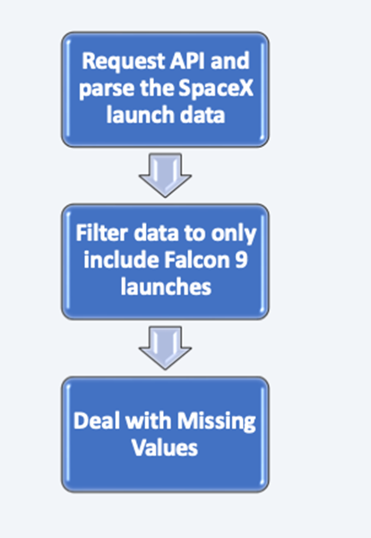
Data Collection – SpaceX API
spacex_url=https://api.spacexdata.com/v4/launches/past
response = requests.get(spacex_url)
Link to GitHub: https://github.com/tomasa22/Coursera_IBM_Capstone/blob/main/jupyter-labs-spacex-data-collection-api.ipynb

Slide 10
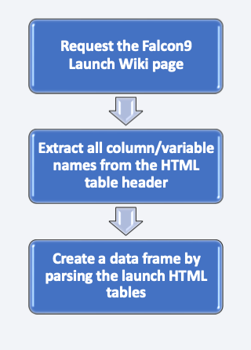
Data Collection - Scraping
Data obtained from: https://en.wikipedia.org/w/index.php?title=List_of_Falcon_9_and_Falcon_Heavy_launches&oldid=1027686922
Link to GitHub: https://github.com/tomasa22/Coursera_IBM_Capstone/blob/main/jupyter-labs-webscraping.ipynb

Slide 11
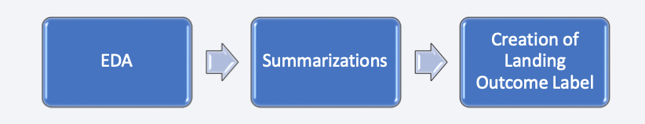
Data Wrangling
Calculated the number of launches on each site
Calculated the number and occurrence of each orbit
Calculated the number and occurence of mission outcome of the orbits
Created a landing outcome label
Link to GutHuB: https://github.com/tomasa22/Coursera_IBM_Capstone/blob/main/labs-jupyter-spacex-Data%20wrangling.ipynb

Slide 12
EDA with Data Visualization
Following graphs were created to better understand data
relationship between Flight Number and Launch Site
relationship between Payload and Launch Site
relationship between success rate of each orbit type
relationship between FlightNumber and Orbit type
relationship between Payload and Orbit type
launch success yearly trend
Link to GitHub: https://github.com/tomasa22/Coursera_IBM_Capstone/blob/main/edadataviz.ipynb

Slide 13
EDA with SQL
SQL queries performed
Names of the unique launch sites in the space mission
5 records where launch sites begin with the string 'CCA‘
The total payload mass carried by boosters launched by NASA (CRS)
Average payload mass carried by booster version F9 v1.1
The date when the first succesful landing outcome in ground pad was acheived.
The names of the boosters which have success in drone ship and have payload mass greater than 4000 but less than 6000
The total number of successful and failure mission outcomes
The names of the booster_versions which have carried the maximum payload mass
The records which will display the month names, failure landing_outcomes in drone ship ,booster versions, launch_site for the months in year 2015
Rank the count of landing outcomes (such as Failure (drone ship) or Success (ground pad)) between the date 2010-06-04 and 2017-03-20, in descending order.
Link to GitHub: https://github.com/tomasa22/Coursera_IBM_Capstone/blob/main/jupyter-labs-eda-sql-coursera_sqllite.ipynb

Slide 14
Build an Interactive Map with Folium
Markers, circles, lines and marker clusters were used with Folium Maps
Markers indicate points like launch sites;
Circles indicate highlighted areas around specific coordinates, like NASA Johnson Space Center;
Marker clusters indicates groups of events in each coordinate, like launches in a launch site; and
Lines are used to indicate distances between two coordinates.
Link to GitHub: https://github.com/tomasa22/Coursera_IBM_Capstone/blob/main/lab_jupyter_launch_site_location.ipynb

Slide 15
Build a Dashboard with Plotly Dash
Created pie chart visualizing launch success counts
Add a Range Slider to Select Payload
Plot a scatter plot with the x axis to be the payload and the y axis to be the launch outcome
Link To GitHub: https://github.com/tomasa22/Coursera_IBM_Capstone/blob/main/spacex_dash_app.py

Slide 16
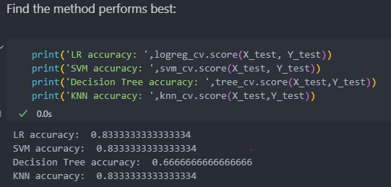
Predictive Analysis (Classification)
LR, SVM, Decision Tree and KNN object were created and fit with provided GridSearchCV object to find best parameters.
Accuracy of models were evaluated:
Link to GitHub: https://github.com/tomasa22/Coursera_IBM_Capstone/blob/main/SpaceX_Machine%20Learning%20Prediction_Part_5.ipynb

Slide 17
Results
Success of launches for SpaceX increased with number of years of experience
Best accuracy model are LR, SVM and KNN
83.3% accuracy for all 3 models
Why are results so similar ?
Most success launch sites is KSC LC-39A

Slide 18

Section 2

Slide 19
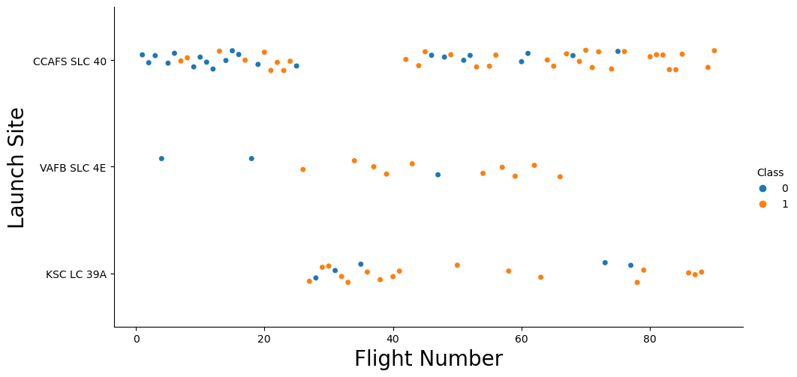
Flight Number vs. Launch Site
Most launches are from site CCAFS SLC 40

Slide 20
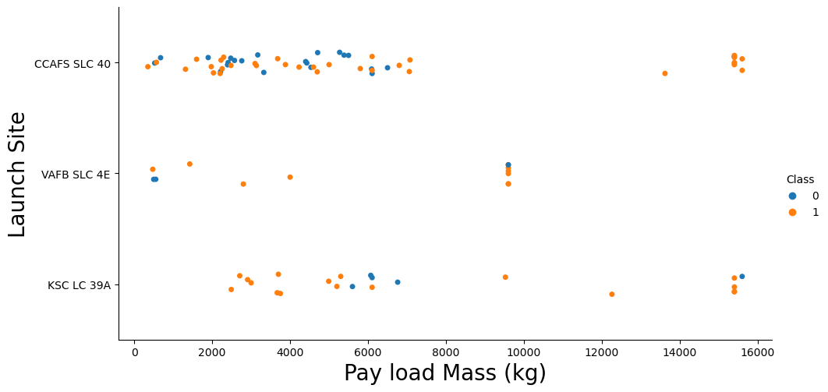
Payload vs. Launch Site
Most common launches are with payload up to 8000 kg

Slide 21
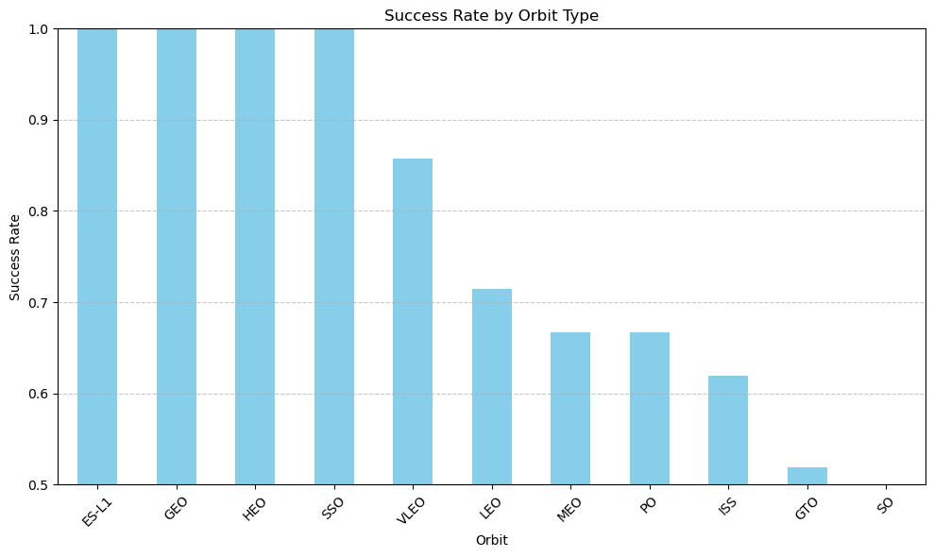
Success Rate vs. Orbit Type
Highest success rate are orbits : ES-L1, GEO, HEO, SSO

Slide 22
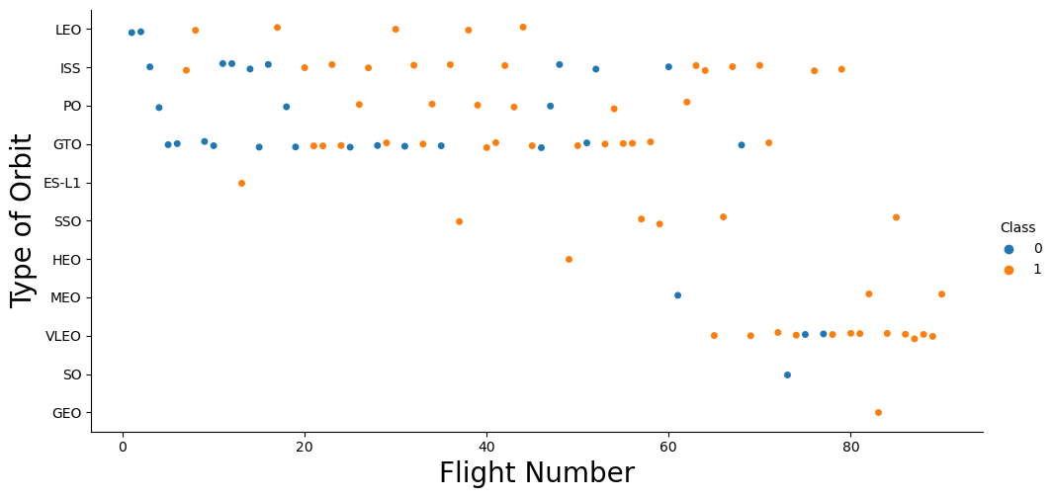
Flight Number vs. Orbit Type
With increasing flight numbers (years) more prominent type of orbits are reached.
Showing increasing experience of SpaceX delivery system

Slide 23
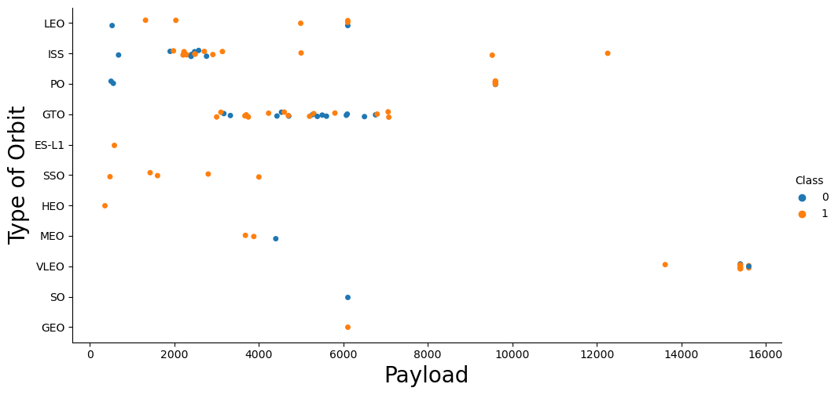
Payload vs. Orbit Type
Heavy payloads have more successful rate

Slide 24
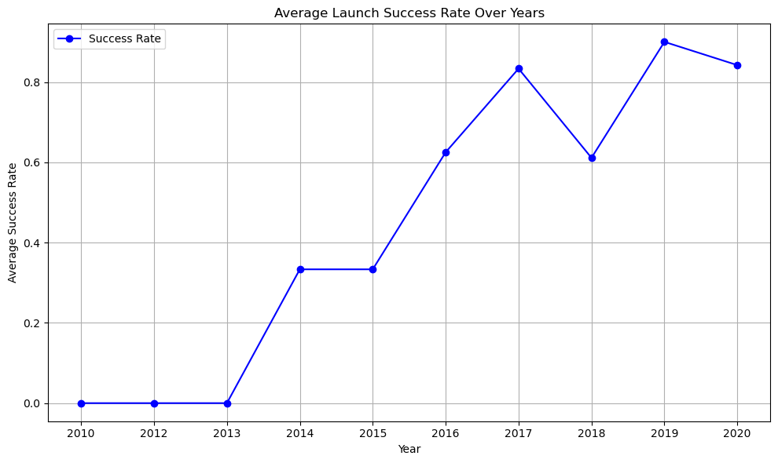
Launch Success Yearly Trend
After 2013 success of of launched increased systematically

Slide 25
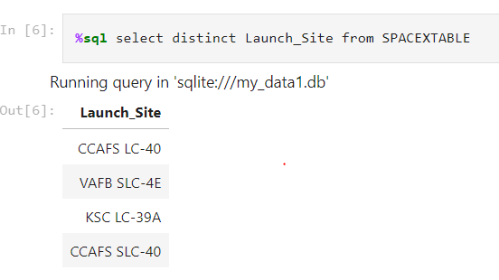
All Launch Site Names
CCAFS LC-40
VAFB SLC-4E
KCS LC-39A
CCAFS SLC-40

Slide 26
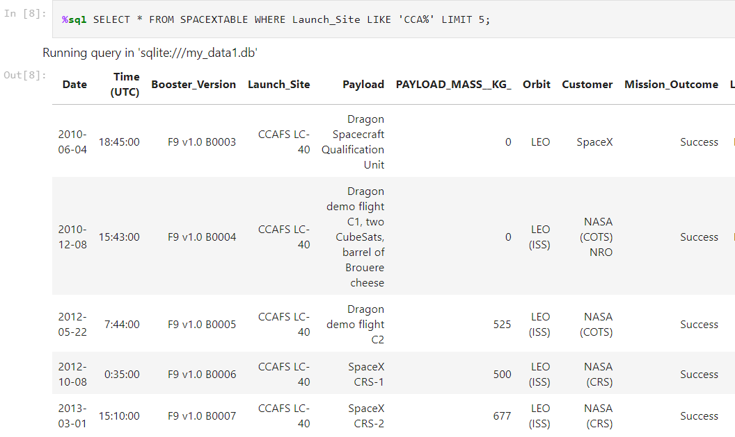
Launch Site Names Begin with 'CCA'
Find 5 records where launch sites begin with `CCA`

Slide 27
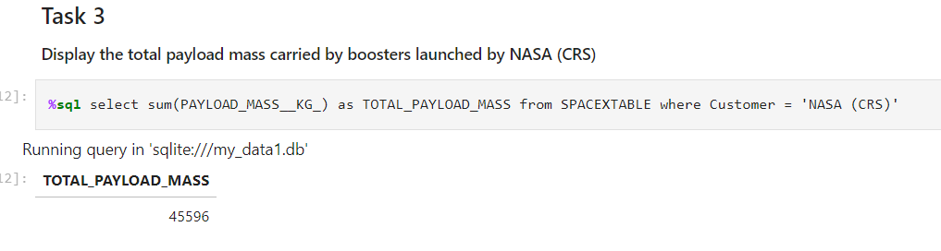
Total Payload Mass
Total payload carried by booster launched by NASA = 45596 kg

Slide 28
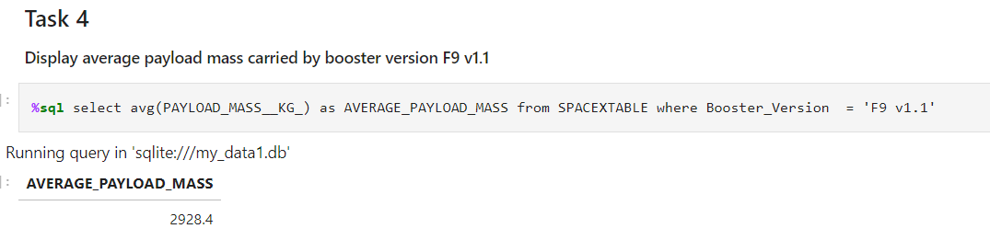
Average Payload Mass by F9 v1.1
Average payload mass carried by booster version F9 v1.1 = 2928.4 kg

Slide 29
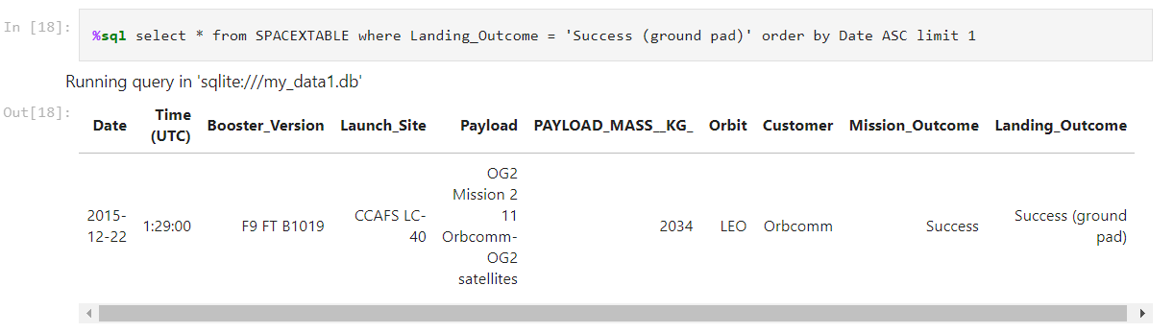
First Successful Ground Landing Date
SQL query to find dates of the first successful landing outcome on ground pad

Slide 30
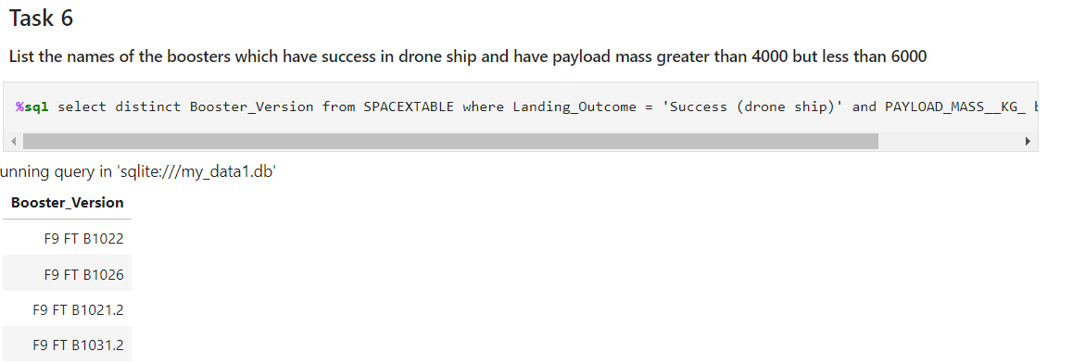
Successful Drone Ship Landing with Payload between 4000 and 6000
List the names of boosters which have successfully landed on drone ship and had payload mass greater than 4000 but less than 6000
%sql select distinct Booster_Version from SPACEXTABLE where Landing_Outcome = 'Success (drone ship)' and PAYLOAD_MASS__KG_ between 4000 and 6000

Slide 31
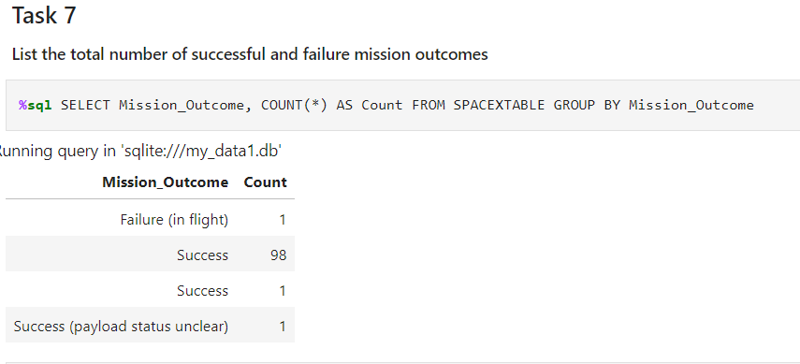
Total Number of Successful and Failure Mission Outcomes
SQL query

Slide 32
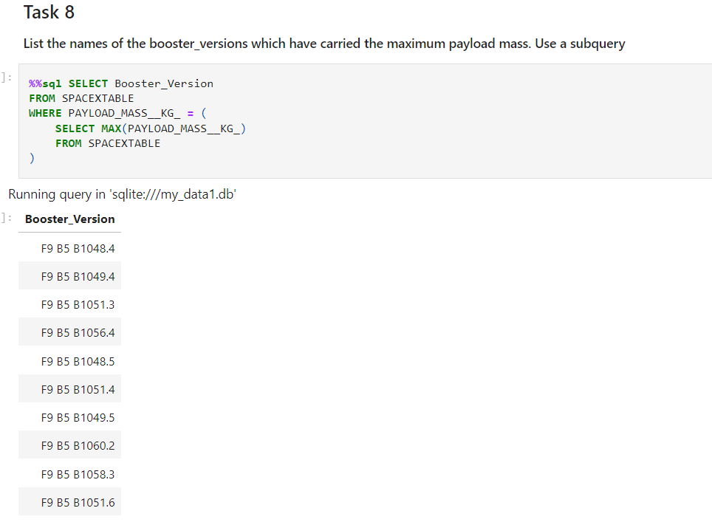
Boosters Carried Maximum Payload
SQL query to list of the booster version which have carried maximum payload

Slide 33
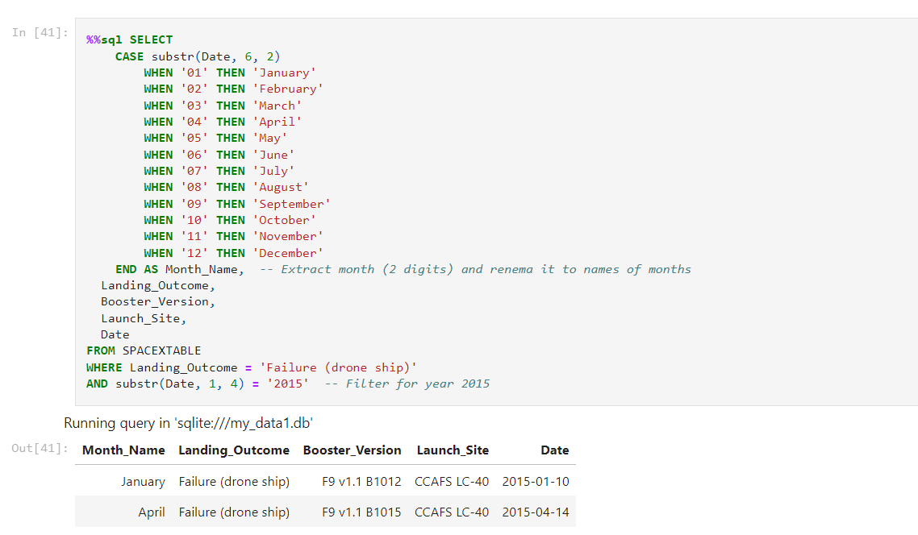
2015 Launch Records
List the failed landing_outcomes in drone ship, their booster versions, and launch site names for in year 2015

Slide 34
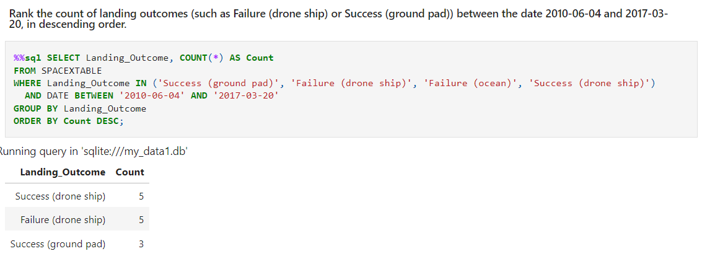
Rank Landing Outcomes Between 2010-06-04 and 2017-03-20
Rank the count of landing outcomes (such as Failure (drone ship) or Success (ground pad)) between the date 2010-06-04 and 2017-03-20, in descending order

Slide 35

Section 3

Slide 36
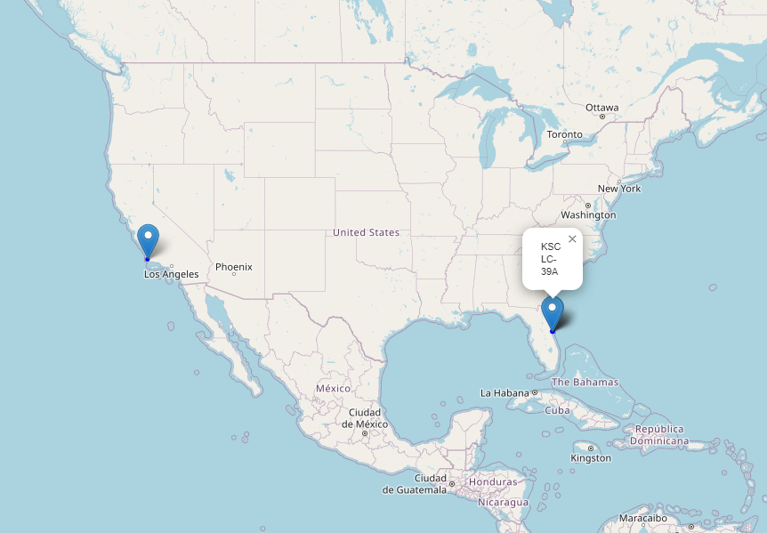
Position of launch sites on map
Position of launch sites on map with markers

Slide 37
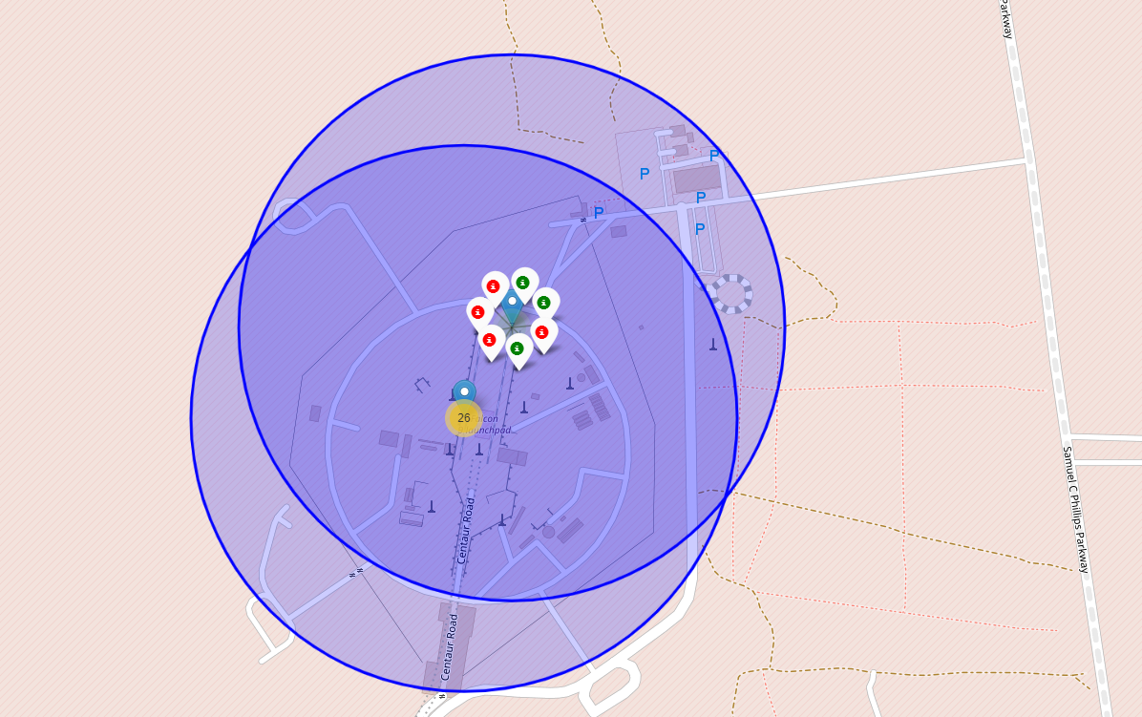
Success/Failure launches for each launch site
Launches are grouped to clusters are labeled by green marker for success and red for failure

Slide 38
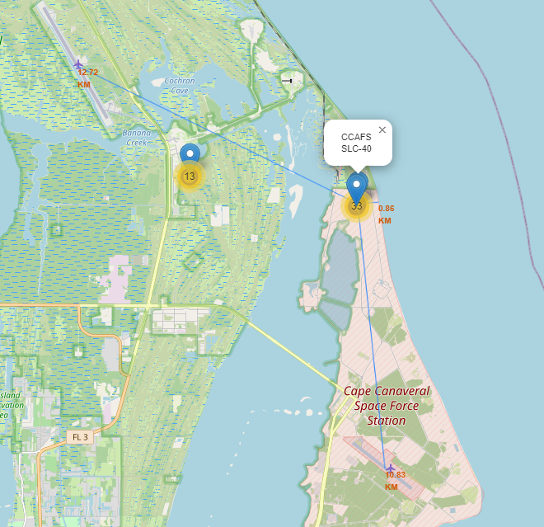
Nearest landing strips and shoreline
Nearest landing strips (in km) and shorelines for launch site CCAFS SLC-40

Slide 39

Section 4

Slide 40
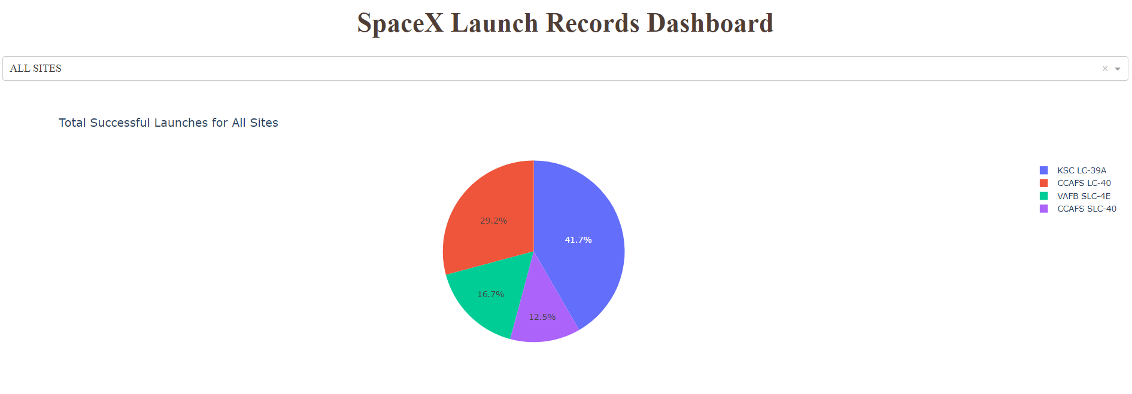
Total Launches for All Sites
Launch site KCS LC-39A has the most successful rate with 41.7%

Slide 41
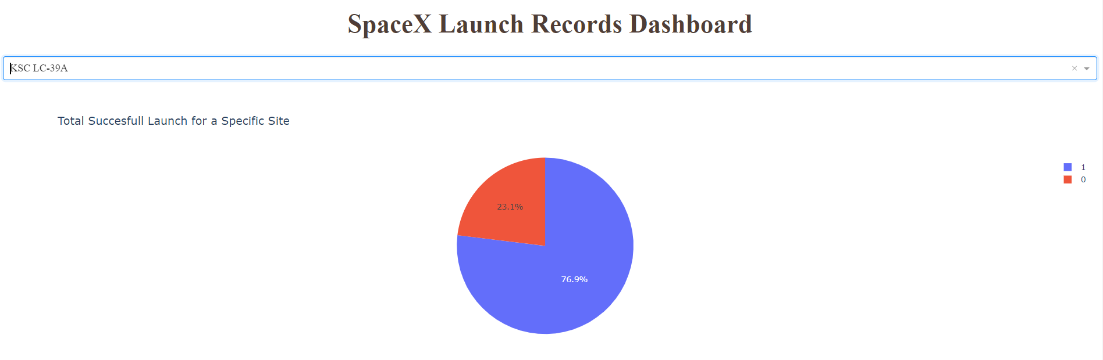
Total Successful Launch for Specific Site
KSC LC-39A has 76.9% success rate and failure rate 23.1%

Slide 42
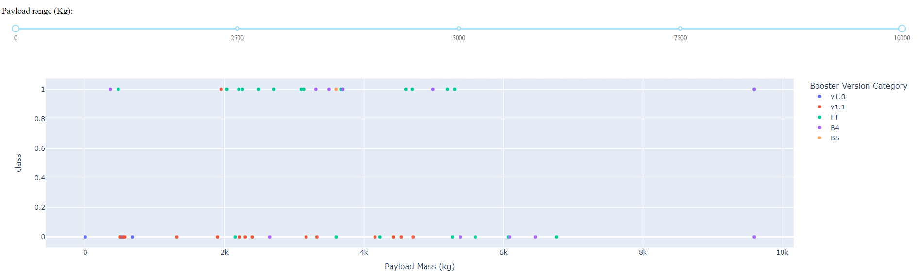
Payload vs launch outcome
Here is show success/failure (class) for each booster version and how much payload they were carrying

Slide 43

Section 5

Slide 44

Classification Accuracy
Three best performing models are LR, SVM and KNN

Slide 45
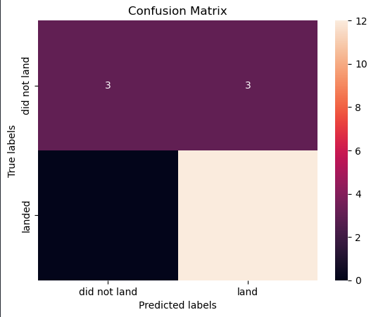
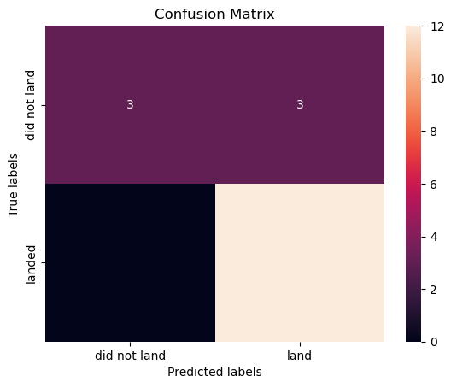
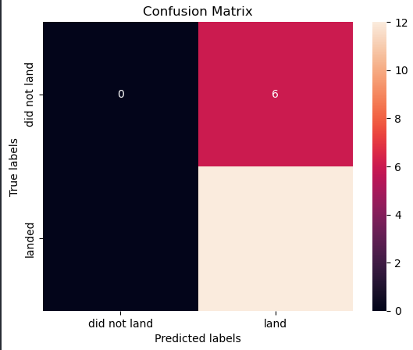
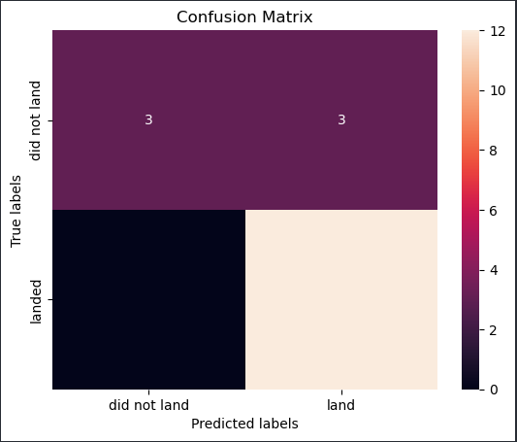
Confusion Matrix
Here is my problem I have 3 best models not only one and final results are confusing: no number for did not land , land in Landed idk why ☺
LR SVM Decision Tree KNN

Slide 46
Conclusions
The larger the flight amount at a launch site, the greater the success rate at a launch site.
Launch success rate started to increase in 2013 till 2020.
Orbits ES-L1, GEO, HEO, SSO, VLEO had the most success rate.
KSC LC-39A had the most successful launches of any sites

Slide 47


